Slide 1
Iterator and Composite Patterns
P-353

Slide 2
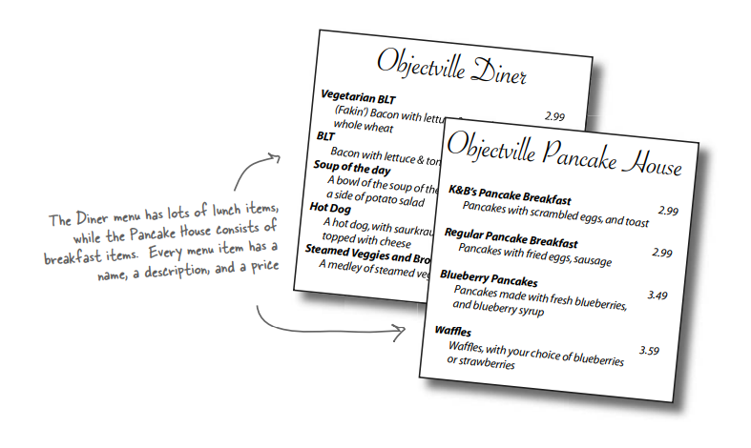
Check out the Menu Items

Slide 3
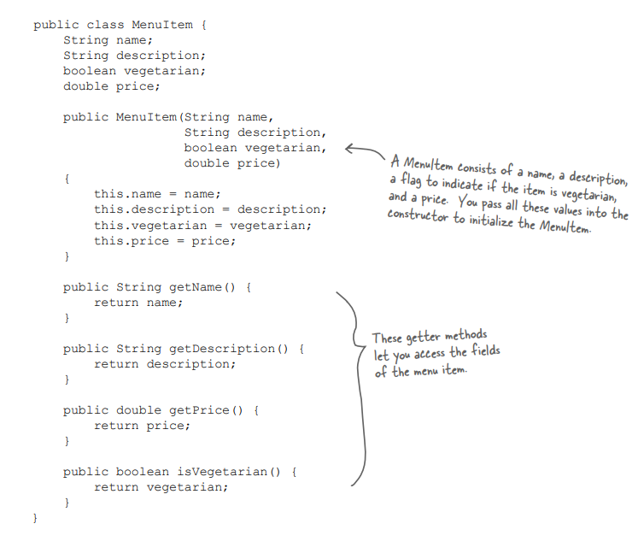
Class Definition of a menu item

Slide 4
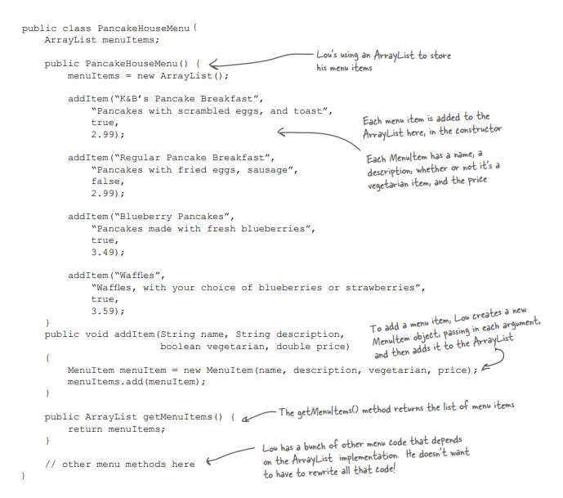
An implementation of PancakeHouseMenu
ArrayList implementation of MenuItems

Slide 5
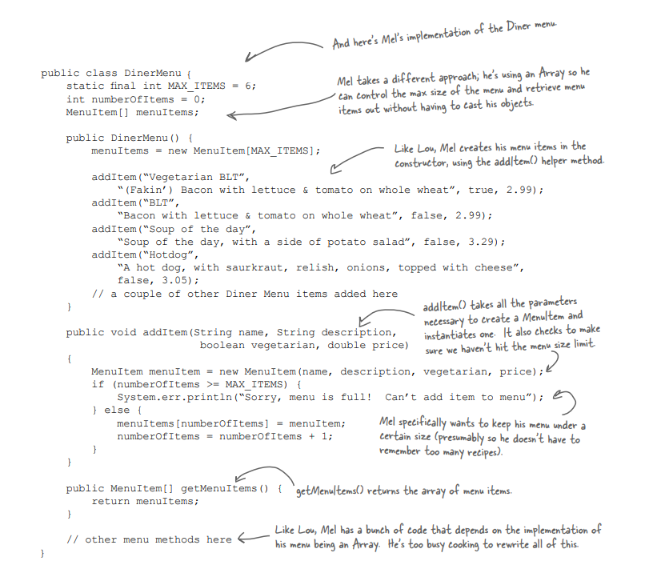
An implementation of DinerMenu
Array Implementation

Slide 6
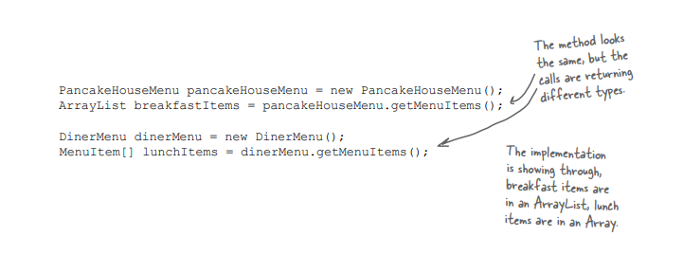
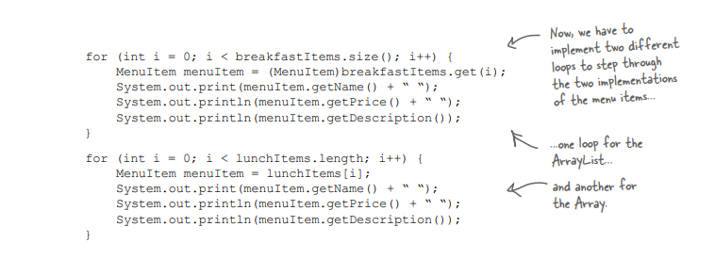
Main issues
Printing function:
How arraylist and array varies

Slide 7
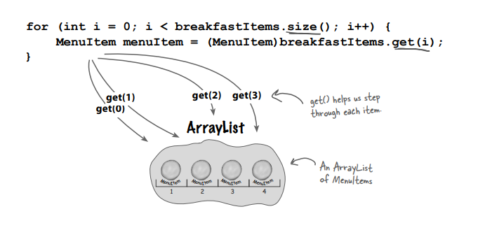
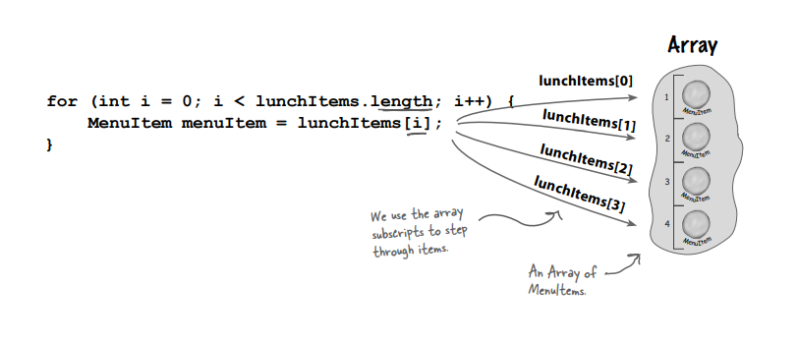
ArrayList vs Array in Java

Slide 8
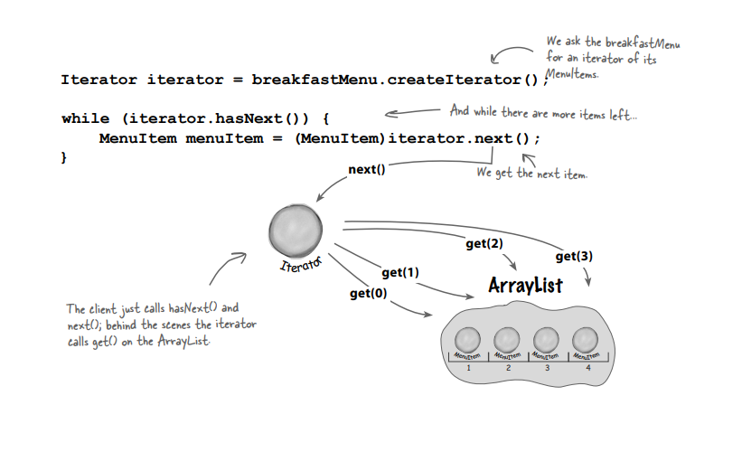
Encapsulating the iteration (ArrayList)

Slide 9
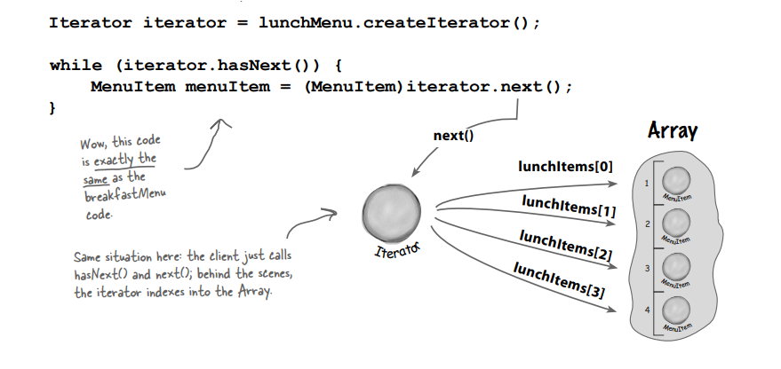
Encapsulating the iteration (Array)

Slide 10
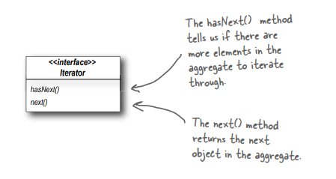
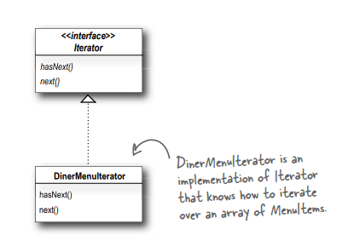
Meet the Iterator Pattern

Slide 11
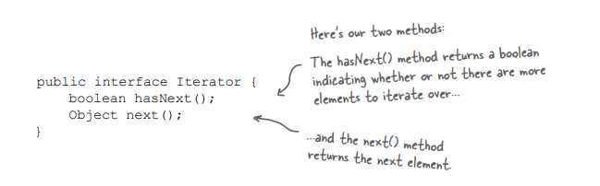
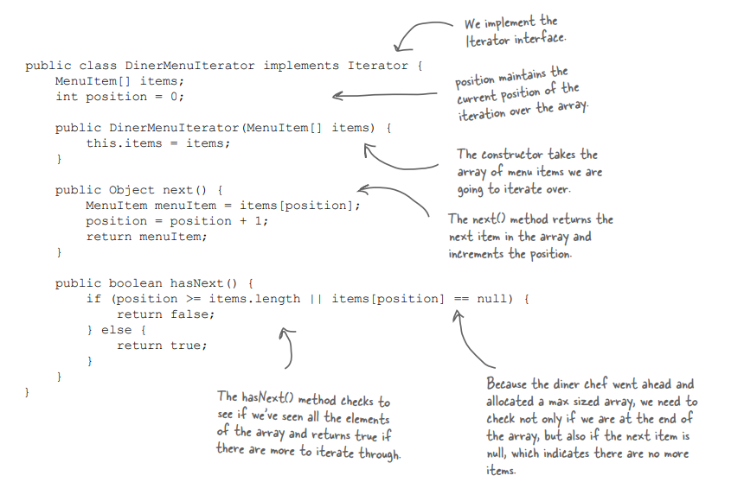
Iterator implementation for an array

Slide 12
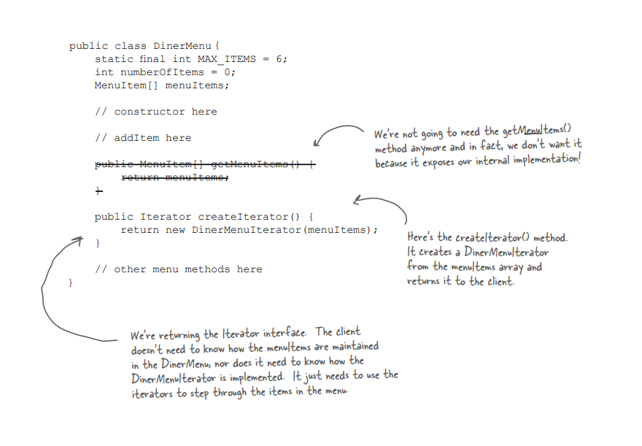
Reworking the Diner Menu with Iterator

Slide 13
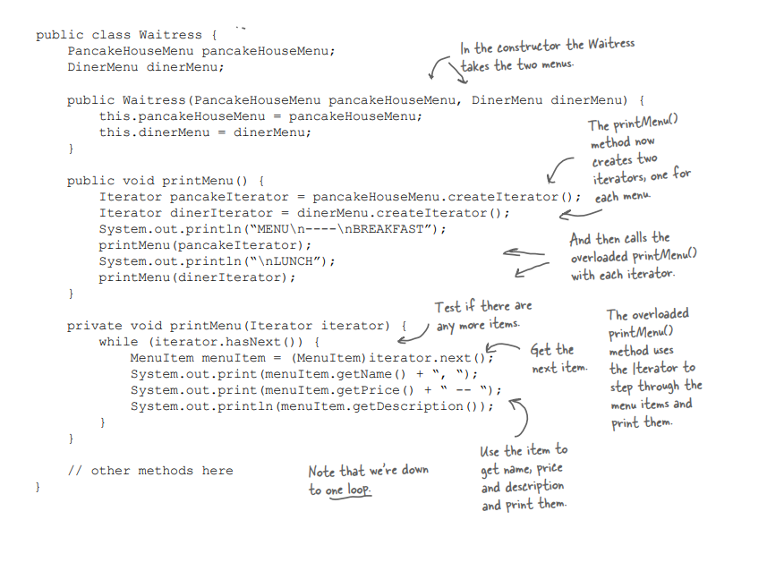
Fixing up the Waitress code

Slide 14
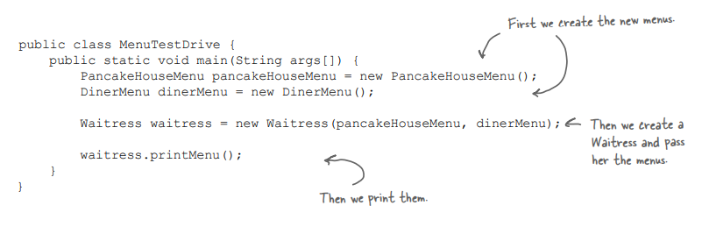
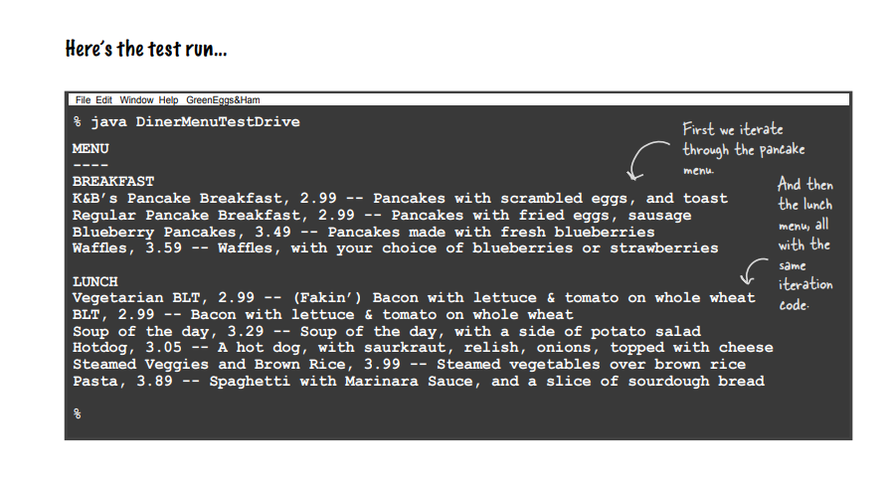

Slide 15
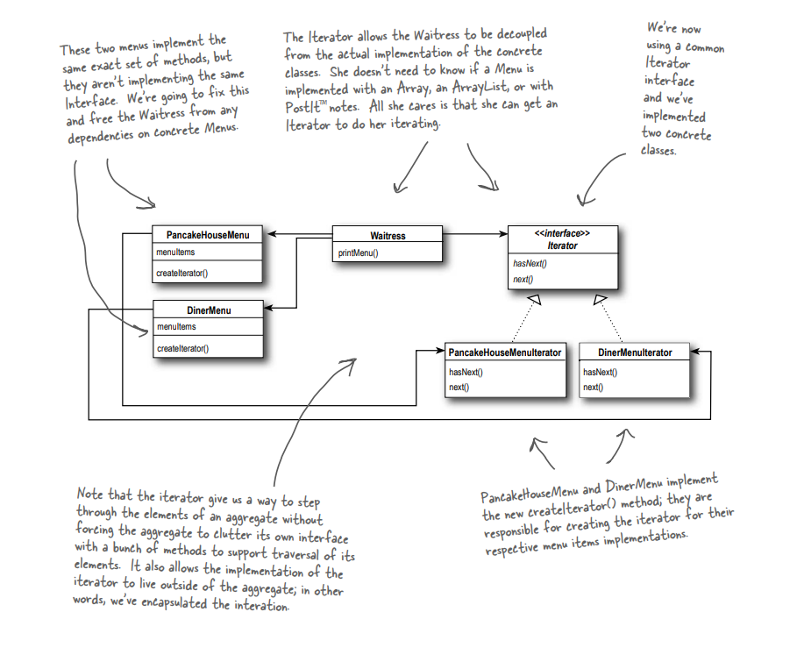
Current Design

Slide 16
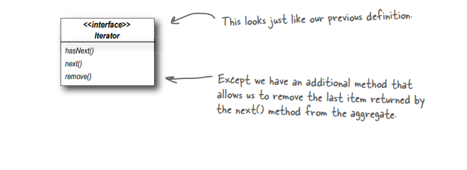
Making some improvements...

Slide 17
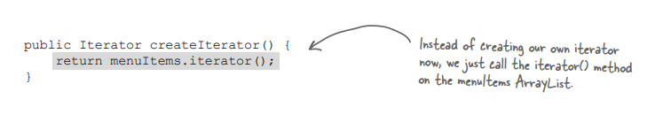
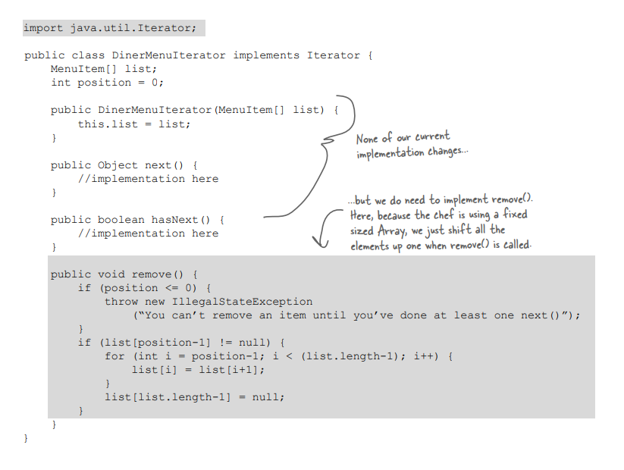
Cleaning things up with java.util.Iterator
change in PanCakeHouseMenu
It uses arrayList, a built in iterator can be used
next (), hasNext () and remove () all are built already
Need to add remove () in the concret definition
As arrays do not support built in java util iterator

Slide 18
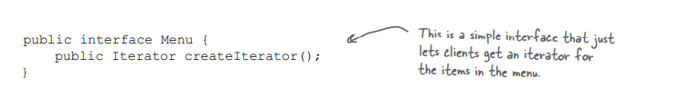
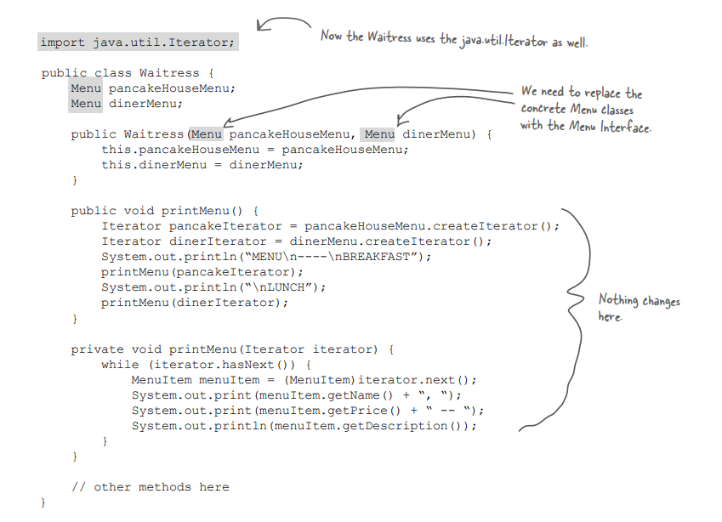
A modification of the waitress class
PanCakeHouse and DinerMenu both going to implement this

Slide 19
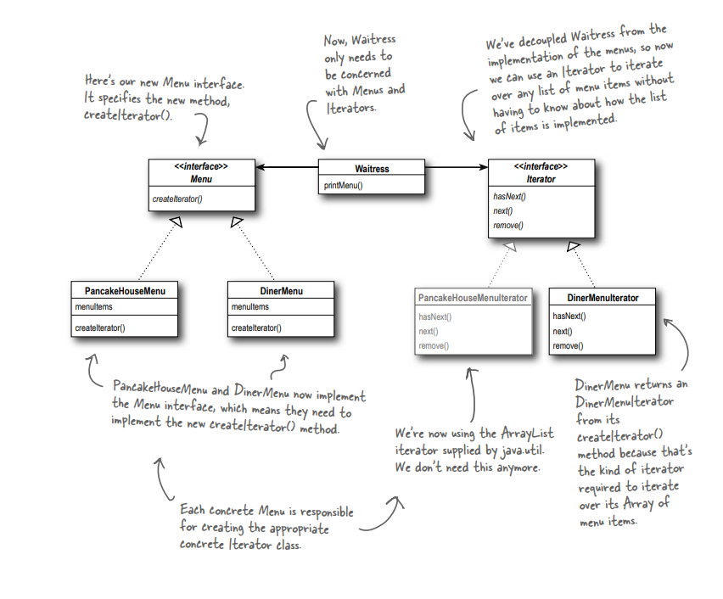
Current Picture

Slide 20
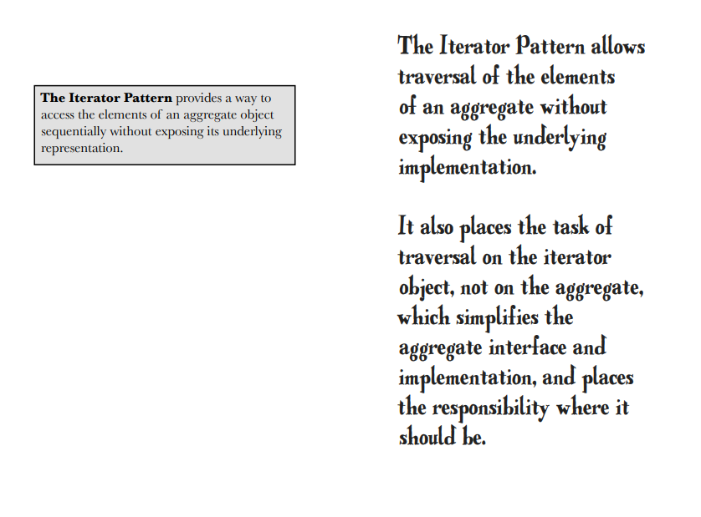
Iterator Pattern defined

Slide 21
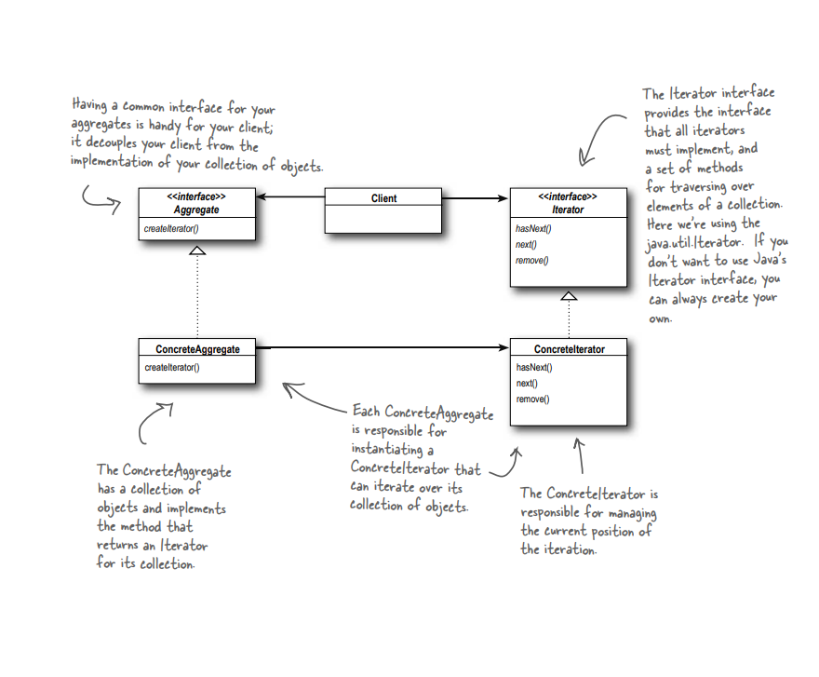

Slide 22
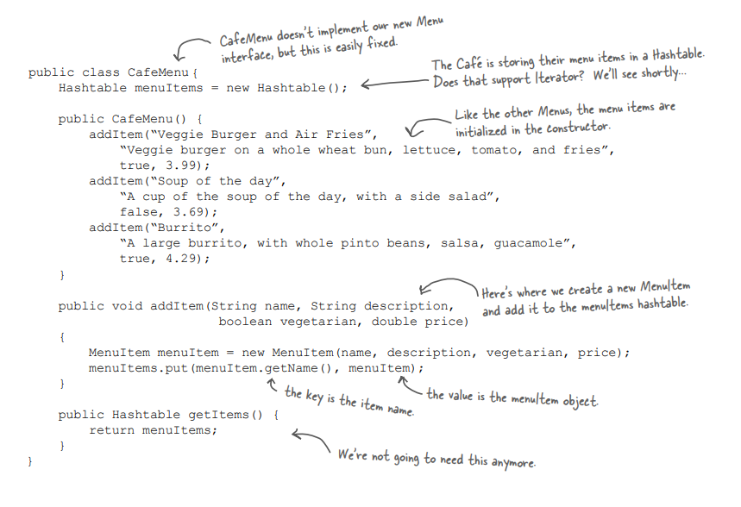
CafeMenu class

Slide 23
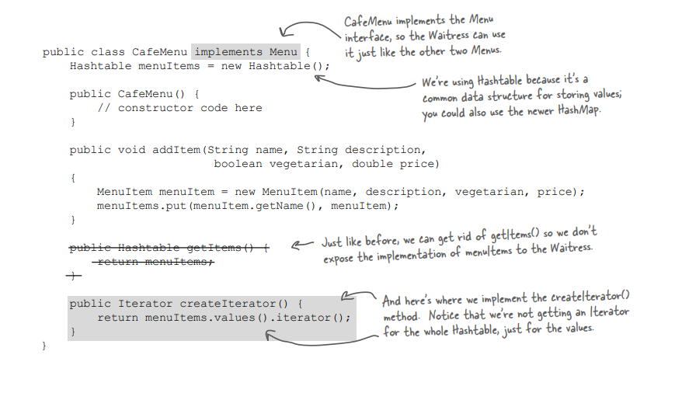
Implementing the Menu interface

Slide 24
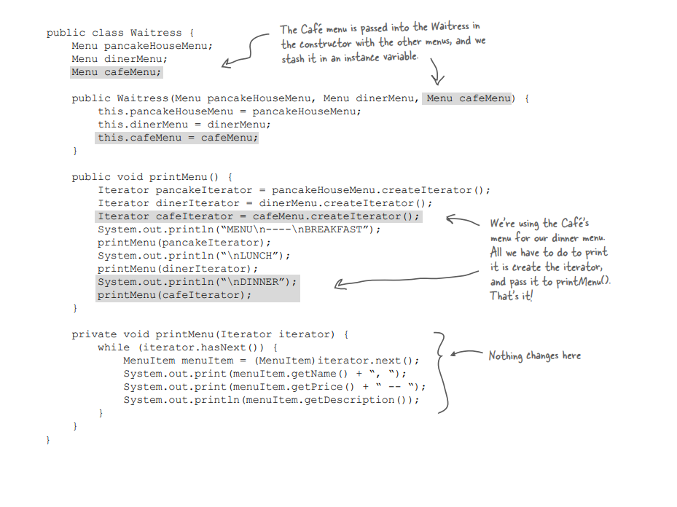
The Base Waitress class

Slide 25
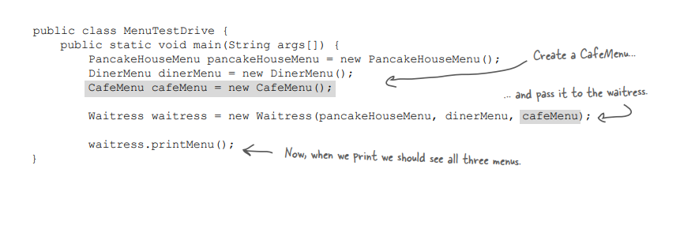
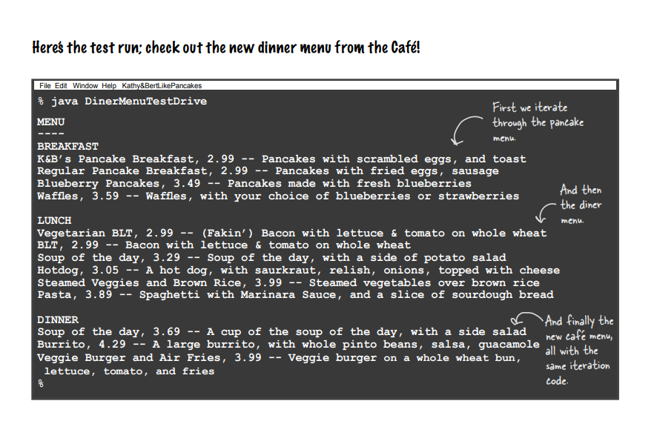
The DriverCode

Slide 26
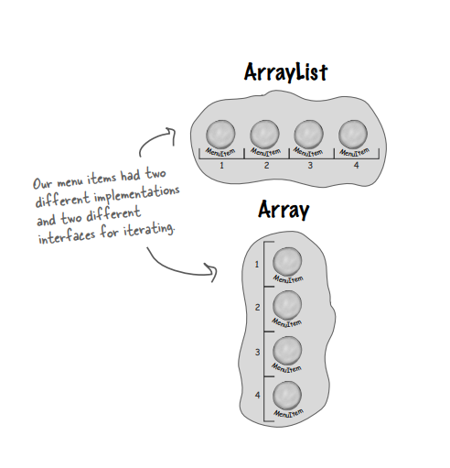
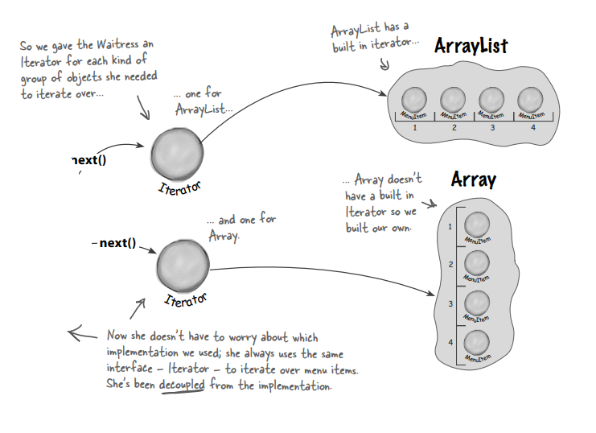
What we had vs What we did

Slide 27
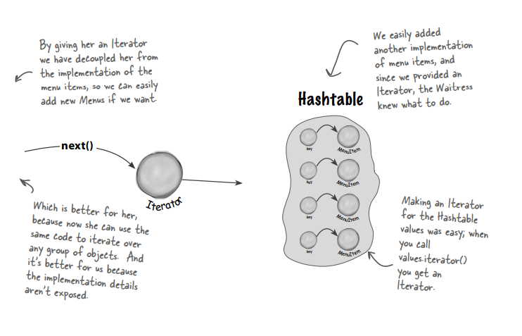
More Extension

Slide 28
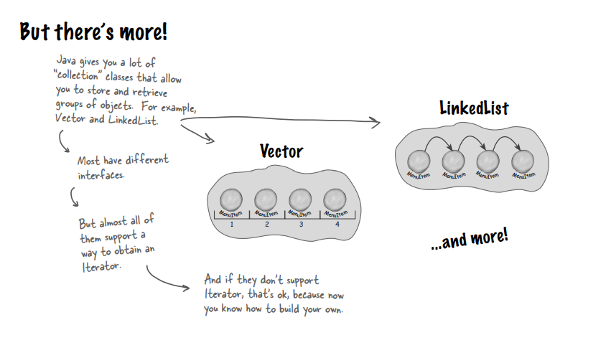
More and More Extension

Slide 29
Composite Pattern

Slide 30
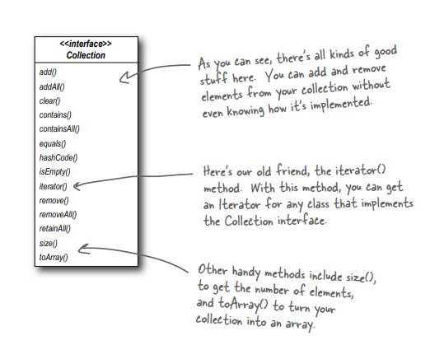
Iterator and Collections
Just each concrete iterator class will implement this interface and will be summoned by a collection class

Slide 31
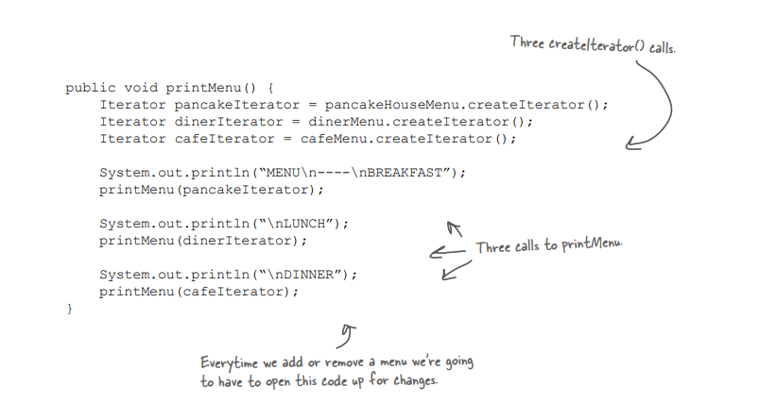
Is the Waitress ready for prime time?
ArrayList
Array
HashTable

Slide 32
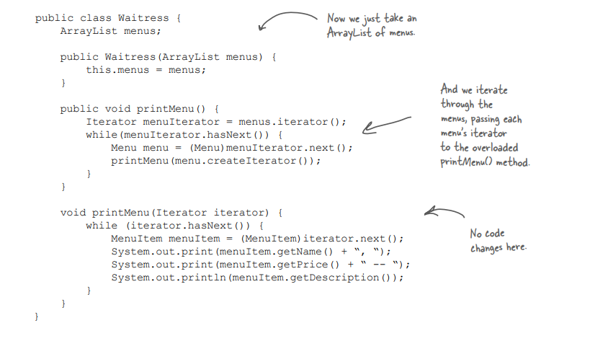

Slide 33
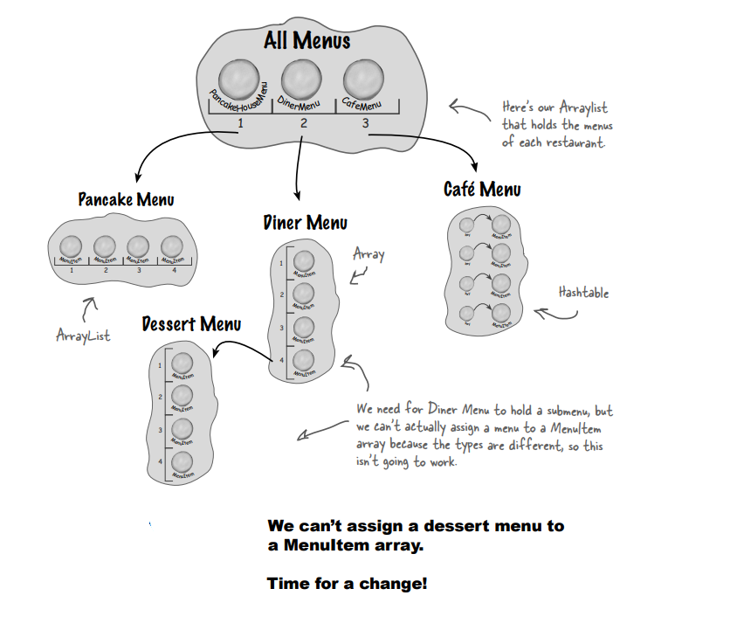
A sub menu Dessert Menu under Diner Menu

Slide 34
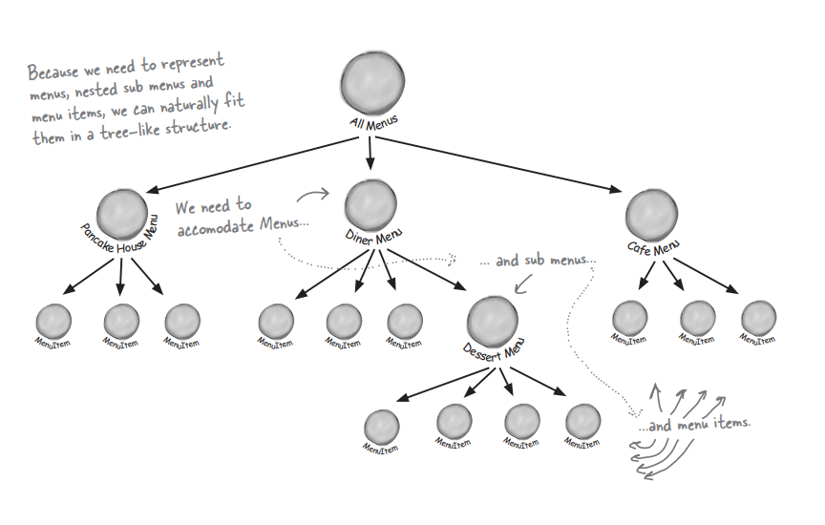
Our Plan

Slide 35
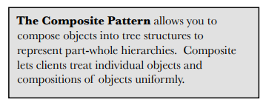
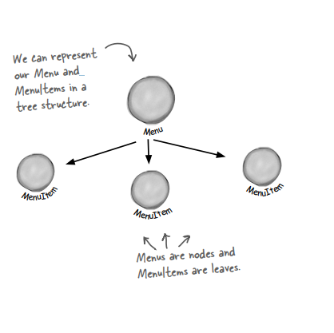
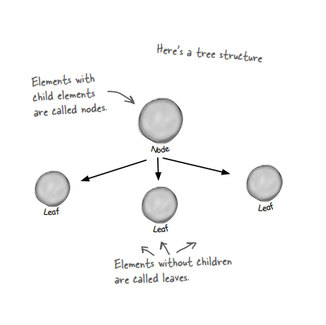
The Composite Pattern defined

Slide 36
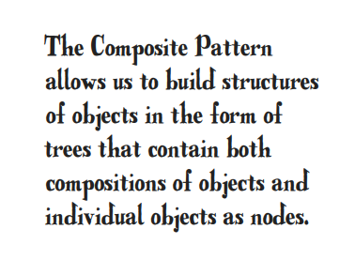
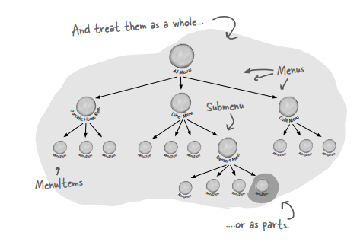
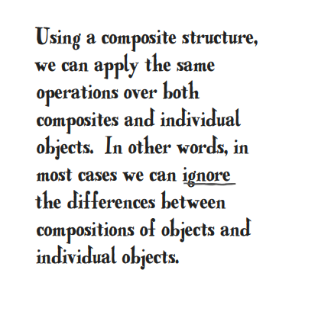

Slide 37
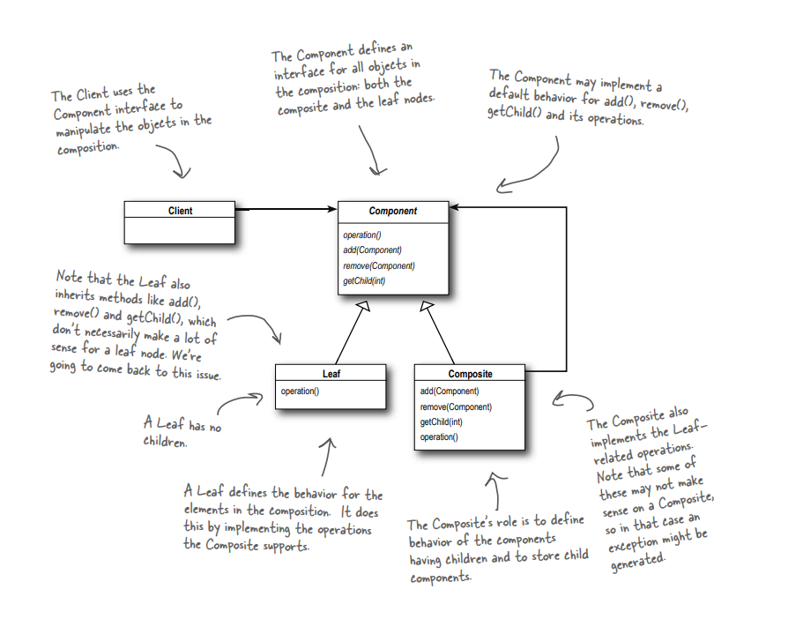
Composite Pattern Class Diagram

Slide 38
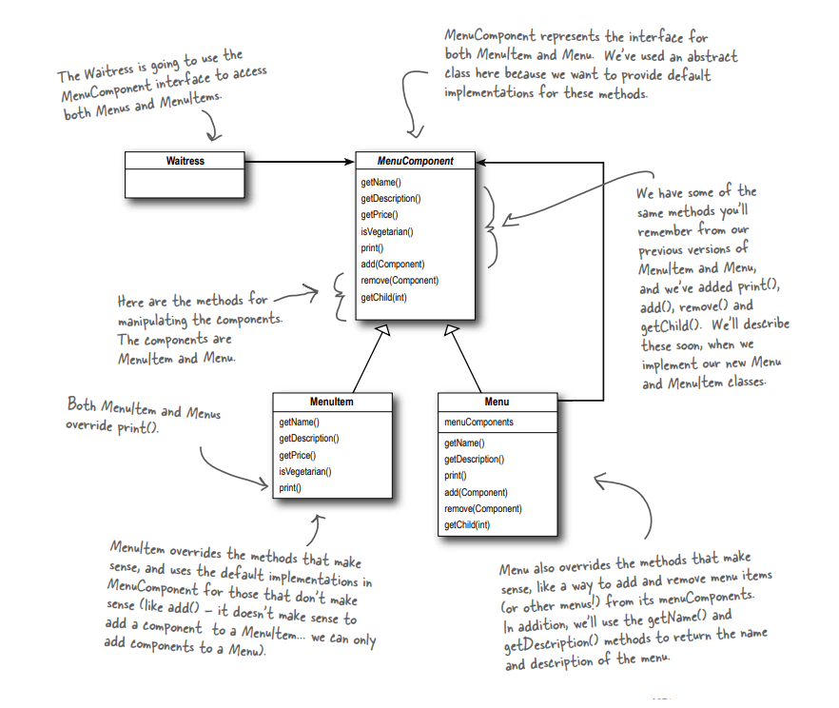
Designing Menus with Composite

Slide 39
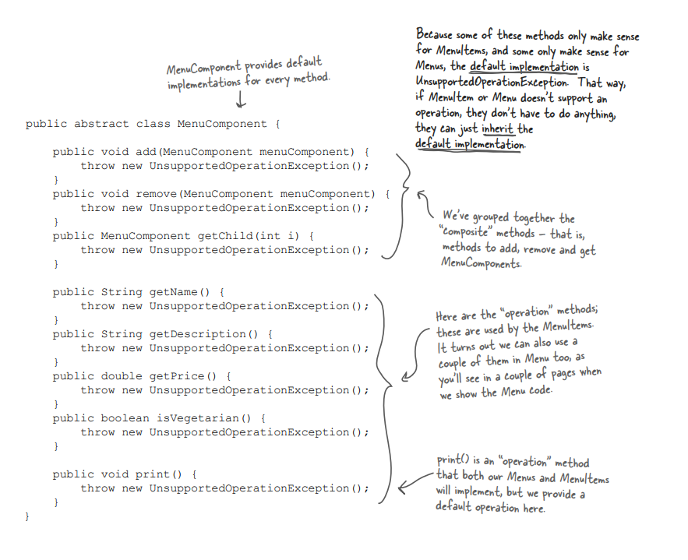
Implementation of MenuComponent abstract class

Slide 40

Implementing the MenuItem

Slide 41

Implementing the Menu
Issue Lies here

Slide 42


Slide 43



Slide 44

Now for the test drive...

Slide 45


Slide 46

Flashback to Iterator
Creating custom iterator to traverse in the data structure

Slide 47


Flashback to Iterator
A single item, so null iterator to handle special case
Creating custom iterator to traverse in the data structure

Slide 48

The Composite Iterator

Slide 49

The Null Iterator

Slide 50


Summary

